Slide 1
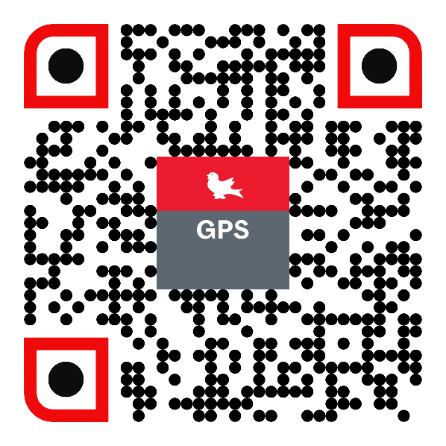
Graduate & Postdoctoral Studies
Graduate Funding
Student Orientation
Fall 2023
https://www.mcgill.ca/gps/funding
Notes:
Hello and welcome to McGill University.
I am here to day to introduce you to Graduate and Postdoctoral Studies: Graduate Funding

Slide 2
GPS Graduate Funding Unit’s role
Dissemination of information for All types of graduate funding including,
International Student funding,
Federal and Provincial funding,
Sponsorships,
Internships,
Adjudication and processing of centrally-administered fellowships and awards from GPS-run competitions
Development of policies regarding graduate student funding and student eligibility
Advocate for students
Graduate Funding
Notes:
We have 4 major roles. They are
Making sure that funding information is available for our grad students including,
International Student funding,
Federal and Provincial funding,
Sponsorships,
Internships,
We keep a fair and transparent Adjudication process of all centrally-administered fellowships and awards from GPS-run competitions
We are able to assist in the Development and modification of policies regarding graduate funding and student eligibility; both internally to McGill and with outside agencies.
And always, we give our voice to support and advocate for our grad students

Slide 3
2 Types of Funding
Internal
Financial support distributed by the University, which comes from McGill central funds, endowments, donations and professors’ research grants. Some opportunities are available for which a separate application needs to be submitted, but for most internal funds, students receive a funding letter outlining their funding package at the time of admission.
All PhD students receive a standardized funding letter. Learn more about funding letters on our website.
Employment possibilities such as Research or Teaching Assistantships may be also available. Note that funds received for these are considered salary for employment and are subject to the corresponding Union’s collective agreements.
Graduate Funding
Notes:
There are two Principal Types of Funding – Internal and External
I will begin with Internal funding
This encompasses support distributed by the University, coming from McGill central funds. Some internal funding opportunities require that you submit an application. Most however do not and are outlined for you in your funding letter at the time of admission.
--All PhD students receive a standardized funding letter and you can find out more about them by following the link here.
--There may be employment opportunities in your unit such as Research or Teaching Assistantships. Note that funds received for these are considered salary for employment and are subject to the corresponding Union’s collective agreements.
Make sure that you speak with your Graduate Program Coordinator.

Slide 4
Graduate Funding – Internal funds
$$ McGill Internal $$
Faculty
Grad Program
You!
Who? Click here
Graduate Funding
Notes:
A big part of McGill’s central funds work like this:
Monies come into a big pot that is administered by GPS
Using a formula, GPS allocates portions of the pot with each Faculty
Each Faculty uses their own formula and policies to re-distribute their share to their Units
Each Unit is then tasked with offering to students (PhD..see your funding letter!) This letter is issued together with your offer of admission.
Any questions should be directed to your GPC who will in turn follow the path upwards to get responses back to you.

Slide 5
2 Types of Funding
External
Federal Tri-Agency (Masters & Doctoral)
NSERC – CRSNG (Natural Science & Engineering)
CIHR – IRSC (Health Research)
SSHRC – CRSH (Social Science & Humanities)
Provincial Agencies (Masters & Doctoral)
FRQNT (Natural Science & Engineering)
FRQS (Health Research)
FRQSC (Social Science & Humanities)
*Anyone submitting an application to one of the Provincial agencies are required to send the application number to their Unit
Many other foundations or private enterprises offer student support.
Speak with your supervisor! Visit our website! Google!
Canadian & Perm. Res. Only
Nominated by Unit,
GPS forwards to agency
NO citizenship restrictions!
Apply directly to agency, not through GPS
Graduate Funding
Notes:
Now we have External Funds. These are monies awarded to students from funding sources external to McGill.
The most prominent are the Canadian federal Tri-Agencies, (NSERC, CIHR, & SSHRC) and the Provincial FRQ (FRQNT, FRQS, & FRQSC)
Tri-Agency CGSD Deadline is 01 October for Phd and CGSM is 01 Dec for Masters.
Open to all Canadian Citizens, Perm residents, and protected persons « under the immigration act…[application process begins here at McGill so you speak to GPC
FRQ: Deadlines are 1st week of October
Open to all citizenships however out-of-prov and intn’l students must conduct their research in Quebec (other than approved short-term mobility) and the application requires a separate document from your superivor. There is no pre-selection at Mcgill.
You must apply for these awards and our webpages have a lot of helpful and important information for you. Remember it is important to select the correct funding agency that matches with your research.
*Anyone who submits an application to one of the Provincial agencies are required to send the application number to their Unit
Many other foundations or private enterprises offer student support. Talk with your supervisor! Google!

Slide 6
Travel awards
Internal or external
Most require some type of application
GREAT
CGS award holders-MSFSS
https://www.mcgill.ca/gps/funding/travel
Graduate Funding
Notes:
Thinking of including some field research
There are several travel or mobility awards available.
Internal or external
Most require some type of application
GREAT
CGS award holders-MSFSS

Slide 7
Student Information Webinars
Check your McGill
email! Often!
https://www.mcgill.ca/gps/funding/maximize-my-chances
Graduate Funding
Notes:
Graduate funding, along with your unit, is here to support you in the process of applying for funding.
As of Today, these are the upcoming information sessions.
Note that some require registration so please visit this important webpage: “Maximize my Chances” and follow the link to “listing of workshops”
We ask that you verify your eligibility to apply or hold the award BEFORE registering for a session.
Check and READ your McGill email.

Slide 8
Funding for International Students:
Graduate Funding
Notes:
Many of our international students come here thinking that there are no additional funding opportunities for them outside of their funding package.
In addition to the Quebec FRQ funding I mentioned before, Here are some opportunities you should apply for where eligible.

Slide 9
Sponsorships
GPS International Funding Agreements
Co-funded by McGill and an international agency abroad
For Incoming and First Year students
Usually covers
Tuition
International Health Insurance
Annual living allowance
https://mcgill.ca/gps/funding/international
Graduate Funding
Notes:
Sponsorships
These are Agreements between GPS and an International Funding Agency and includes Co-funding by McGill
Sponsorships are restricted to Incoming and First Year students
And usually covers
Tuition
International Health Insurance
Annual living allowance
To see if we have a sponsorship agreement with an agency in your home country, please visit our website shown here where you can also find details on how to apply.

Slide 10
Differential Fee Waivers (DFWs) – External
Quebec exemptions from foreign student differential tuition fees
Bilateral Agreements with foreign countries and Quebec
Students apply through their country’s designated agency
Beware: Deadlines vary by country.
Graduate Funding
Notes:
DFW- Differential Fee Waiver
International fees are MUCH higher than Canadian and Quebec resident students. Almost 15 000$ difference!
To assist some international students, there may be a DFW available
Now a DFW or Differential Fee Waiver is an exemption of the fees charged to international students; the amount you are charged over and above Québec students. This does not include international health insurance.
DFWs come as a result of bilateral agreements between Québec and foreign governments, so not all citizenships are eligible.
To apply, please consult the link indicated. Applications are submitted to an agency in your home country, and the process and deadline will vary depending on the country.

Slide 11
Internship Funding Opportunities
Doctoral Internship Program (DIP)
FRQNT at a College Technology Transfer Centre, MITACS internships, and many others
Program specific:
Graduate Internship Program for Engineering and Computer Science (GrIPECS)
Practera: McGill STEM Industry Project
Internship Funding Opportunities webpage
Graduate Funding
Notes:
It is never too early to think about opportunities to enrich your career.
During your graduate studies there are many opportunities to participate in an internship. An internship will help you explore opportunities in industry, and after graduation, will make your application standout in the job market. I will talk about the Doctoral Internship Program
GrIPECS
Internship support for Masters non-thesis students in all Engineering programs, Bioresource Engineering and Computer Science who are planning to complete an internship in the province of Québec:
Pre-approval process; Internship search assistance; Matching with host partners; Funding available for unpaid opportunities
Practera: Masters students in all Engineering programs, Bioresource Engineering and Computer Science
Students work as part of a consulting team to undertake a business project for a Quebec-based organization for 3 weeks
They research and present opportunities for technical and commercial innovation in a professional report for an industry partner
They collaborate with a professional mentor with a STEM background

Slide 12
Doctoral Internship Program (DIP)
All doctoral programs are eligible to apply
PhD6 or earlier
In-course applications are accepted with supervisor support and up to date myProgress milestones
End of degree applications are accepted for internships between initial thesis submission and defense
7 out of 10 interns are currently working in the same sector or field they interned in ​
42%
of interns were later hired by the organizations they interned with
Graduate Funding
Notes:
Doctoral students will dip their toe and explore opportunities outside of academia before diving into the workforce.
Notice the amazing successes of our doctoral internships. We are very proud of the success of this program.
All doctoral programs are eligible to apply
Must be PhD6 or earlier
In-course applications are accepted if program permits with supervisor support and myProgress milestones are up to date
End of degree applications are accepted if the internship is after the initial thesis submission and before the defense.

Slide 13
Getting Paid
External Fellowships: Fellowships are awarded directly to students by granting agencies, with McGill issuing the payments.
GPS is responsible for disbursing Tri-Agency Fellowships (NSERC, SSHRC and CIHR)
Most all other awards are disbursed by Academic unit
Note: If unsure contact your Graduate Program Coordinator.
If you need to contact us, email graduatefunding.gps@mcgill.ca and attach a copy of your Notice of Award.
Remember: Include your McGill ID NUMBER
Teaching Assistant (TA) or Research Assistant (RA) : Processed through the academic unit – Considered salary for employment, not an award.
Stipends: Paid from a research grant for the student to work on their thesis research which is part of the research program
of the professor’s grant.
Payments processed by the academic unit
Avoid delays
Make sure registration is up to date BEFORE the beginning of the term the award is covering. For internal awards, you must be registered for both Fall AND Winter terms for your funding to be processed.
Submit required documentation to appropriate unit/office (ie: final grades from previous degree)
Update banking information and mailing address on Minerva
https://www.mcgill.ca/gps/funding/getting-paid
Graduate Funding
Notes:
If you receive notification that you have been offered an award from an external funding source, let your Unit know. Go to the webpage: Getting Paid & Maintaining Fellowship and follow instructions there. Submit the required documents to Graduate Funding.
Avoid delays
Make sure you are registered for any term your award will cover before the start of that term. Internal awards recipients must be registered both fall and winter terms.
Submit any and ALL documentation to the appropriate unit/office (ie: final grades from previous degree)
Update banking information and current mailing address on Minerva
Go visit our webpage : Getting Paid & Maintaining Fellowship https://www.mcgill.ca/gps/funding/getting-paid

Slide 14
Funding Weblinks to bookmark
https://www.mcgill.ca/gps/funding
https://www.mcgill.ca/gps/funding/opportunities
https://www.mcgill.ca/gps/funding/understanding-my-funding-letter
https://www.mcgill.ca/gps/funding/internship-funding-opportunities
https://www.mcgill.ca/gps/funding/international
https://www.mcgill.ca/gps/funding/travel
https://www.mcgill.ca/gps/funding/maximize-my-chances
Student Info Sessions / Webinar Registration
https://www.mcgill.ca/gps/funding/getting-paid
Graduate Funding
Notes:
Here are links to some of our webpages

Slide 15
Resources
Workshops and Webinars
Offer support in all aspects if the external funding application process and help maximize your chances
https://www.mcgill.ca/gps/funding/maximize-my-chances
SKILLSETS
Suite of workshops designed for graduate students and postdoctoral fellows to complement research training
https://www.mcgill.ca/skillsets
Tips for writing a research proposal
https://www.mcgill.ca/gps/students/research-tracking/proposals
Graduate Funding

Slide 16
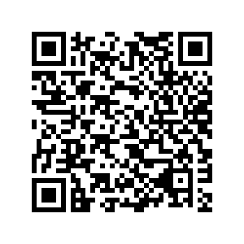
Staying Happy and Healthy at McGill
McGill offers a wide range of resources to support your wellbeing during graduate studies. These resources are there for you, don’t hesitate to make use of them!
Scan the QR code below to see a selection of McGill’s best services for graduate student wellbeing:
https://www.mcgill.ca/gps/students/staying-happy-and-healthy-graduate-studies
Graduate Funding
Notes:
Remember that you need to take care of yourself. This is a very overwhelming time for many of you.

Slide 17
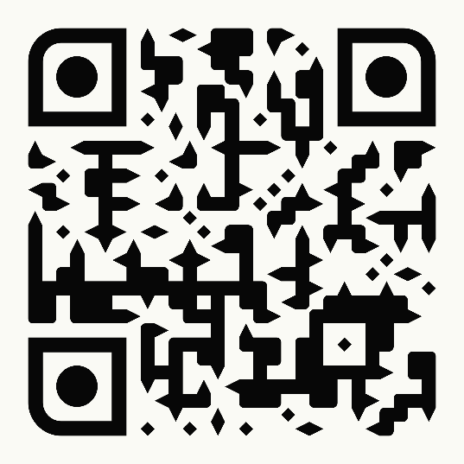
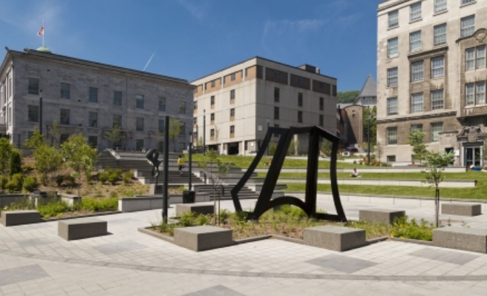
Graduate Funding Team
External funding:
Jan Walker, Fellowships Officer
Diala Alnajem, Adm. & Student Affairs Coord
Labi Yuan, Adm. & Student Affairs Coord
Internal funding:
Lilia Eskildsen Torres, Graduate Funding Manager
Seyissa Pinheiro, Adm. & Student Affairs Coord.
Quinter Faith, Fellowships Administrator
Alycia Bartczak, Outreach Officer (Internships)
Laurent Brisebois, Adm. & Student Affairs Coord
Contact: graduatefunding.gps@mcgill.ca
Remember: Include your McGill ID NUMBER
Graduate Funding
Notes:
Our team – Please be sure to include your McGill ID number at the top of your every message to help us help you easier and more efficiently.

