Slide 1
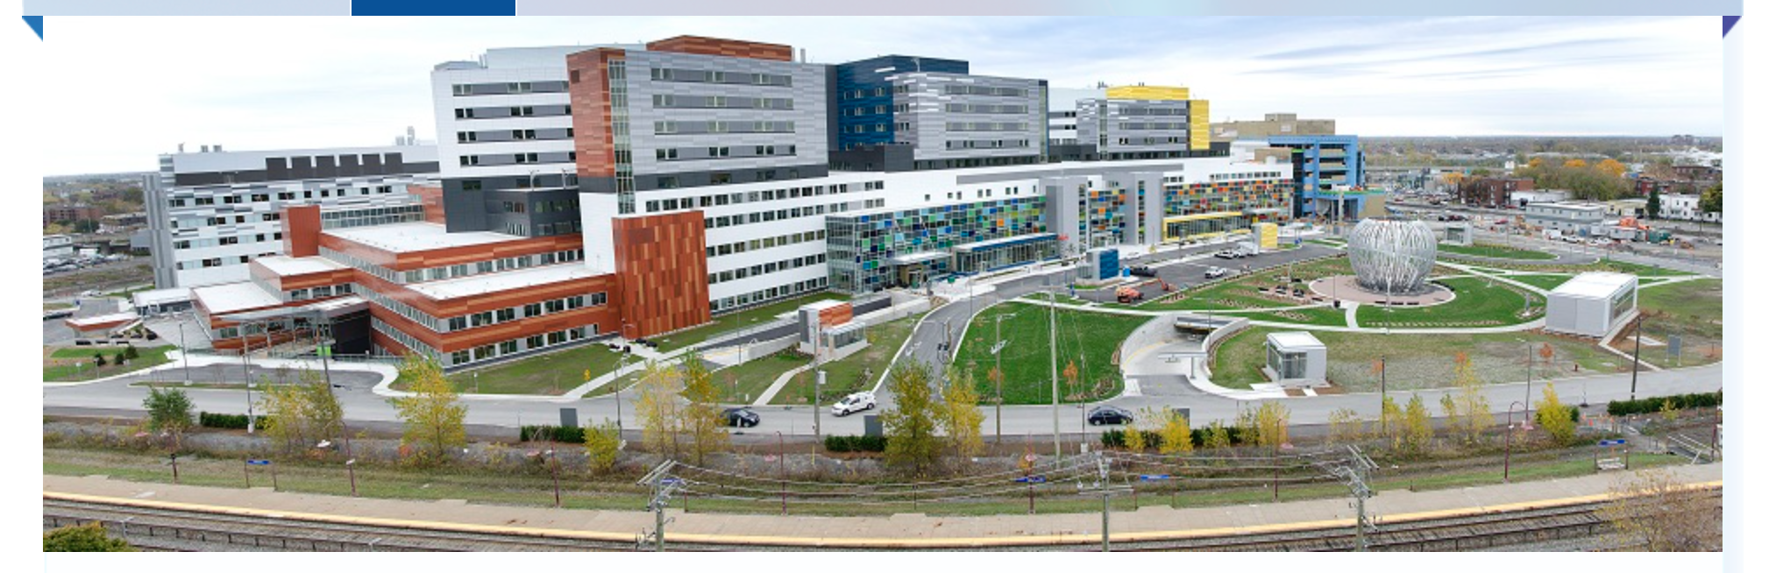
EXPERIMENTAL MEDICINE
Graduate Studies
Academic Advisors
Committee Meetings
Elizabeth Fixman, PhD
elizabeth.fixman@mcgill.ca

Slide 2

You’ve been accepted …. Now what?
Over 400 students

Slide 3
An important goal of the division is to ensure that ALL graduate students are successful
Tracking your progress is one important way to ensure your success
This is a formal process mandated by McGill University Faculty of Graduate and Postdoctoral Studies (GPS)

Slide 4
What does this really mean?

Slide 5
Within two months of starting…
You and your supervisor need to provide the ExMed Division with three documents:
Tracking form page 1, detailing objectives for upcoming 9-12 months
Composition of thesis committee form
Letter of understanding form
**this is an absolute requirement and if not completed, is equivalent to a failure on a formal committee meeting
You should take the lead on making sure this is done by the deadline!

Slide 6
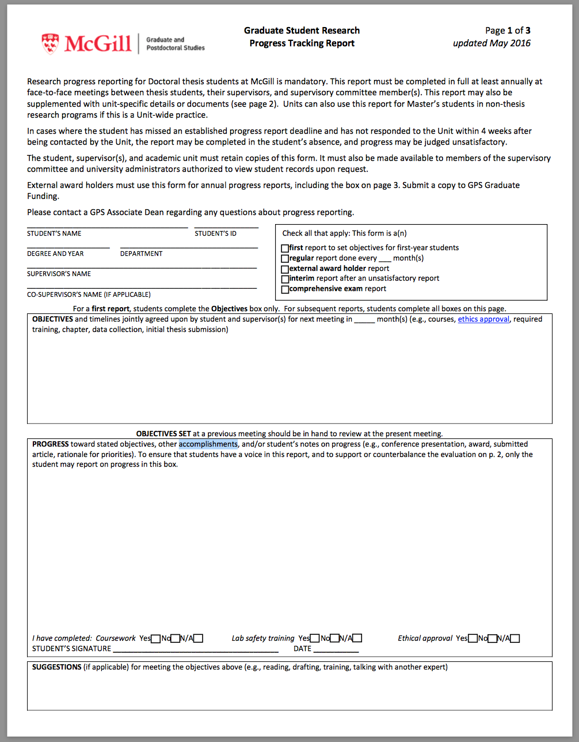
information about you
To be filled out with supervisor within 2 months of start date
your signature

Slide 8
Who?
All MSc and PhD students in the Division of Experimental Medicine.
When?
October 31, 2022
What?
Graduate Progress Tracking Report form
Composition of Thesis and Comprehensive Committees form
Letter of Understanding
**Please look for an email that you have each received from ExMed with the subject line:
Notification: Initial Meeting

Slide 9
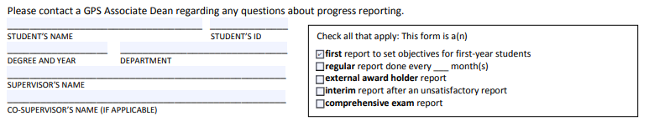
Graduate Progress Tracking Report form (***only page 1***)
Set the objectives and agree on the timeline for the research to be performed in the context of the student’s graduate program.
Information about you

Slide 10
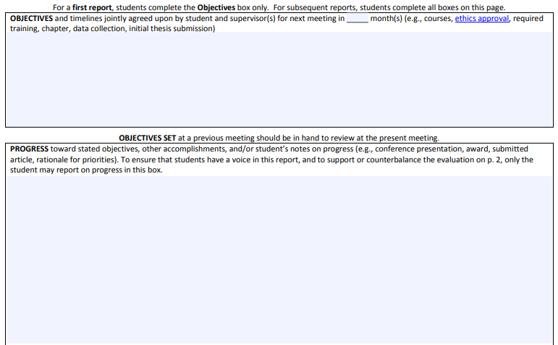
To be filled with your
supervisor(s)
This section is left BLANK (only for the first meeting)
Student’s signature & supervisor’s signature are mandatory. If there is a co-supervisor, this person must also sign the report (preferably on page 1; it can be anywhere, as long as it visible).

Slide 11

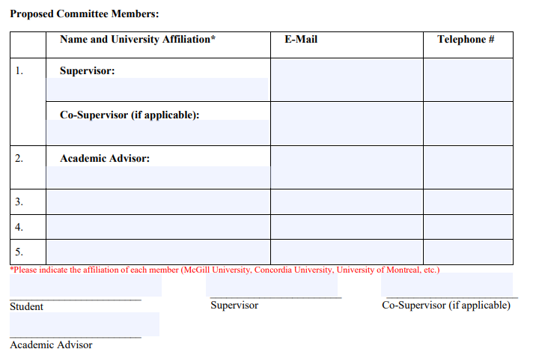
2. Composition of Thesis and Comprehensive Committees form
This information is mandatory
ALL spaces should be filled
Not fewer than 4 members should be listed
Who is my academic advisor? Refer to your letter of acceptance from the Division, unless you had received an email from ExMed informing you of the change of your academic advisor
Dr. __________
xxx.xxxx@mcgill.ca
(514) ______
Dr. __________
Dr. __________
Dr. __________
Dr. __________
Wet signatures or electronic signatures are accepted Typed names are not accepted
Signatures at the bottom are mandatory

Slide 12
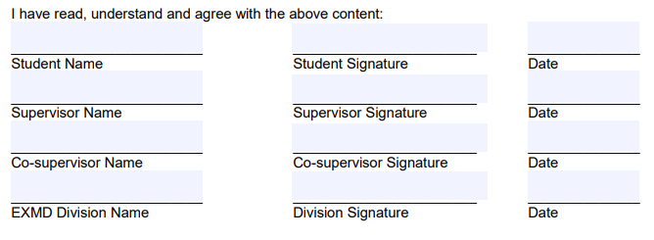
3. Letter of Understanding (LOU)
Mandatory to fill out pages 8 and 9
Mandatory to fill page 10 for double program students
Student and supervisor(s) must sign
Wet signatures or electronic signatures
The LOU will be verified and signed by Sandra Morrison, Student Affairs Officer for ExMed
Please submit all your documents in PDF format only in one email
and by the deadline of October 31.

Slide 13
Confused? Questions?
Ask your Academic Advisor*
Ask the Division

Slide 14
Committee Meetings

Slide 15

What happens at a committee meeting?
www.rappler.com: Your 10 common job interview questions, answered

Slide 16
What happens at a committee meeting?
Goal is to help you, to follow your progress over time
www.rappler.com: Your 10 common job interview questions, answered

Slide 17
Held annually to assess your progress
Comprised of your supervisor, your academic advisor, and two other faculty members with expertise in your project
Goal is to help you, to follow your progress over time
Grant permission to write thesis

Slide 18
Private - Includes only your supervisor (& co-supervisor), your Academic Advisor, and two other faculty members with expertise in your project
You organize the committee meetings. You will receive a reminder email from the Division (each year) indicating when you need to schedule your meeting
  *Please read this entire email!
  *Please remember that ExMed will communicate with you via your McGill email address only
Failure to schedule a committee meeting will result in a failure – so postponing indefinitely is not allowed

Slide 19
Prior to the actual meeting…

Slide 20
You need to send the committee members a summary of your project and the tracking forms (see more below) … this way they know what you are working on
You should prepare these documents with your supervisor
Questions? Ask your Academic Advisor

Slide 21
During the actual meeting…

Slide 22
Prior to the start of the meeting, the committee members discuss your progress - you are not in the room - whether in person or virtual
You then present your research project - in 20-25 minutes
The committee members ask you questions - the goal is to determine if you understand your project and can defend your ideas, to offer advice and encouragement
Afterward, you again leave the room, and the committee discusses your performance & what recommendations they will make

Slide 23
Held annually to assess your progress
Comprised of your supervisor, your academic advisor, and two other faculty members with expertise in your project
Goal is to help you, to follow your progress over time
Grant permission to write thesis

Slide 24
COVID Modifications
Committee meetings can be held over Zoom or in person, as long as everyone follows the guidelines for their institution. The Academic Advisor should have this information, as Academic Advisors are institutionally based.
For committee meetings held via Zoom:
  The Academic Advisor or Supervisor is the host, which allows student to be placed in a ‘waiting room’ for the discussions before/after the committee meeting
  Meetings cannot be recorded
  Please confirm in advance that your wifi connection is stable; if there are problems this needs to be dealt with BEFORE the committee meeting

Slide 25
Tracking Forms

Slide 26
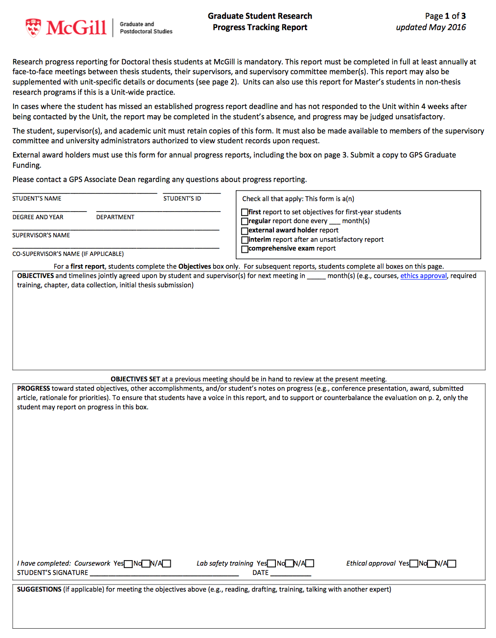
information about you
objectives - for upcoming time frame
progress – since last meeting
your signature

Slide 27
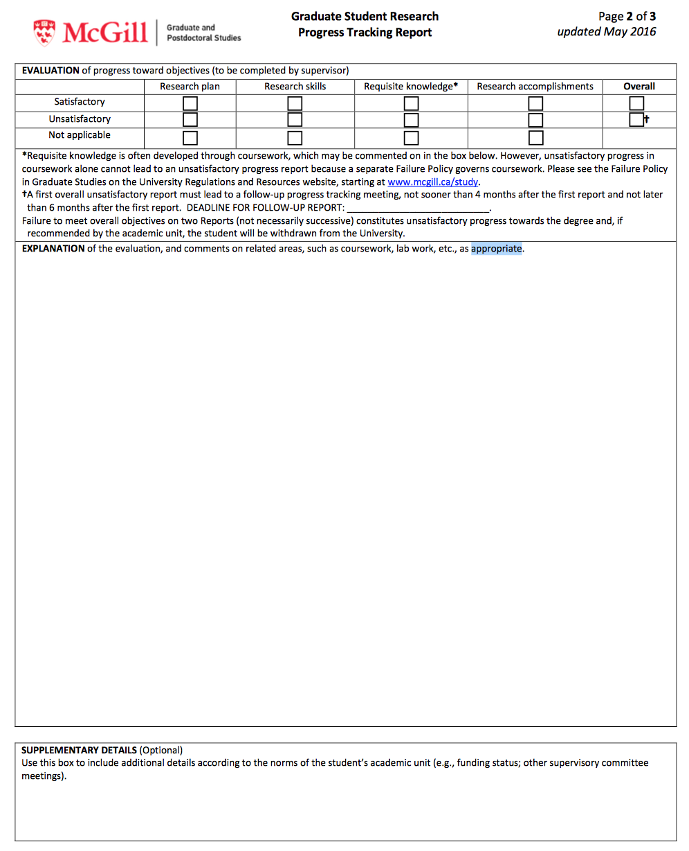
explanation of above ratings

Slide 28
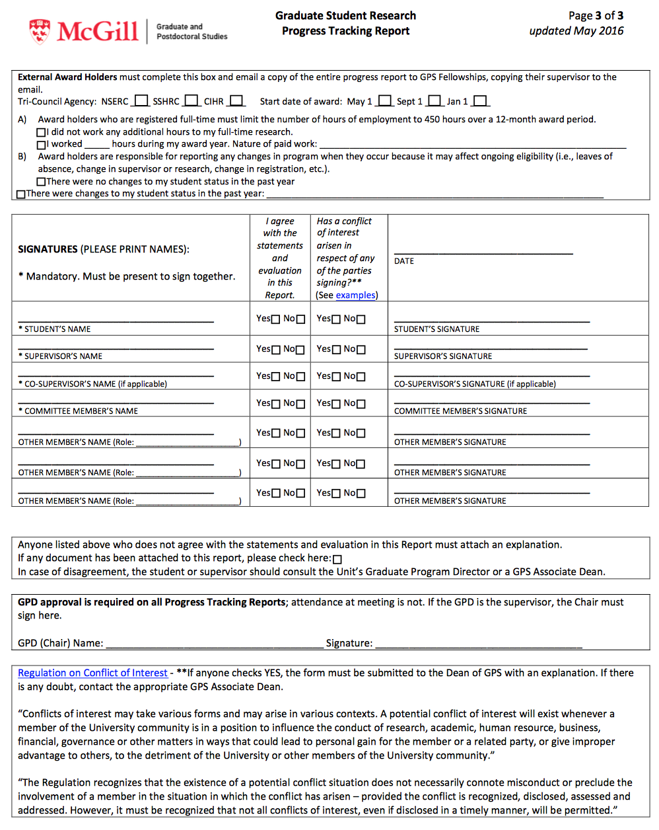

Slide 29
After the actual meeting…

Slide 30
Your Academic Advisor will write up the minutes to describe what happened at the committee meeting
The minutes as well as the completed tracking forms will be sent by the Academic Advisor to ExMed, the student, and the committee members
They are then uploaded onto myProgress (by ExMed) as part of the milestones required to track your progress through your degree program

Slide 31
New since 2022

Slide 32
The oral comprehensive exam for PhD students has been revised and is now more formal with distinct areas of assessment. For detailed information, please visit:
  https://www.mcgill.ca/expmed/graduate-studies/oral-comprehensive-exam
The ability to fast-track from MSc to PhD is linked to passing the oral comprehensive exam prior to completing 4 semesters in the MSc program. For detailed information, please visit:
  https://www.mcgill.ca/expmed/graduate-studies/fast-tracking
You can find Timelines for all graduate programs in ExMed here: https://www.mcgill.ca/expmed/forms
Email me with any questions! elizabeth.fixman@mcgill.ca
**Please note that two options for the oral comprehensive exam and fast-tracking are available to students enrolled prior to Fall 2022. However, for students enrolled from this point forward, the updated versions must be followed.

Slide 33
Tracking Forms and Committee Meetings:
Why must I?

Slide 34
They give you access to faculty members who are interested in your project and who can give you guidance
They provide a formal review of your progress – which might seem ‘painful’ or a waste of time, but is valuable - especially to the unorganized, whether it is the student or the supervisor
They ensure that you stay on track to complete your degree in a reasonable amount of time
In the case of conflict, the tracking forms and committee meeting minutes can protect both the student and the supervisor

Slide 35
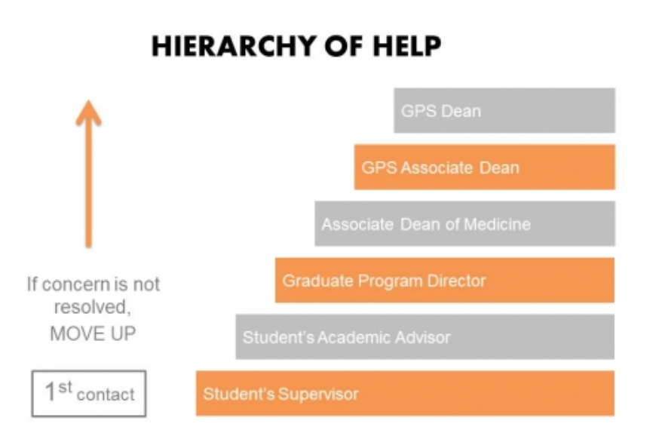
If there are problems…
https://www.mcgill.ca/expmed/policies/conflict-resolution-policy

Slide 36

While you are navigating your way through course requirements, settling into your host lab, completing applicable certificates and training, and starting your experiments, you should consider that the ExMed Division and your Academic Advisor want you to succeed and are a valuable source of support

Slide 37
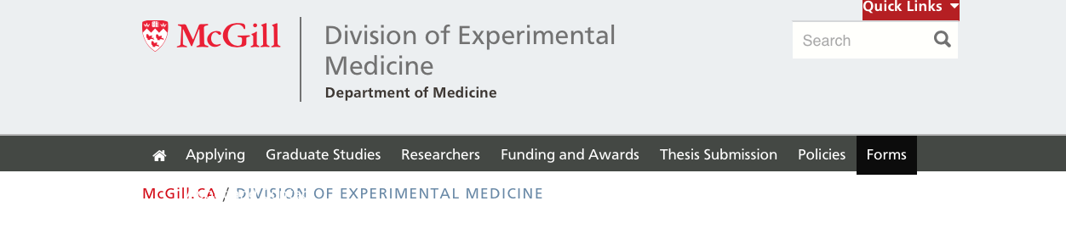
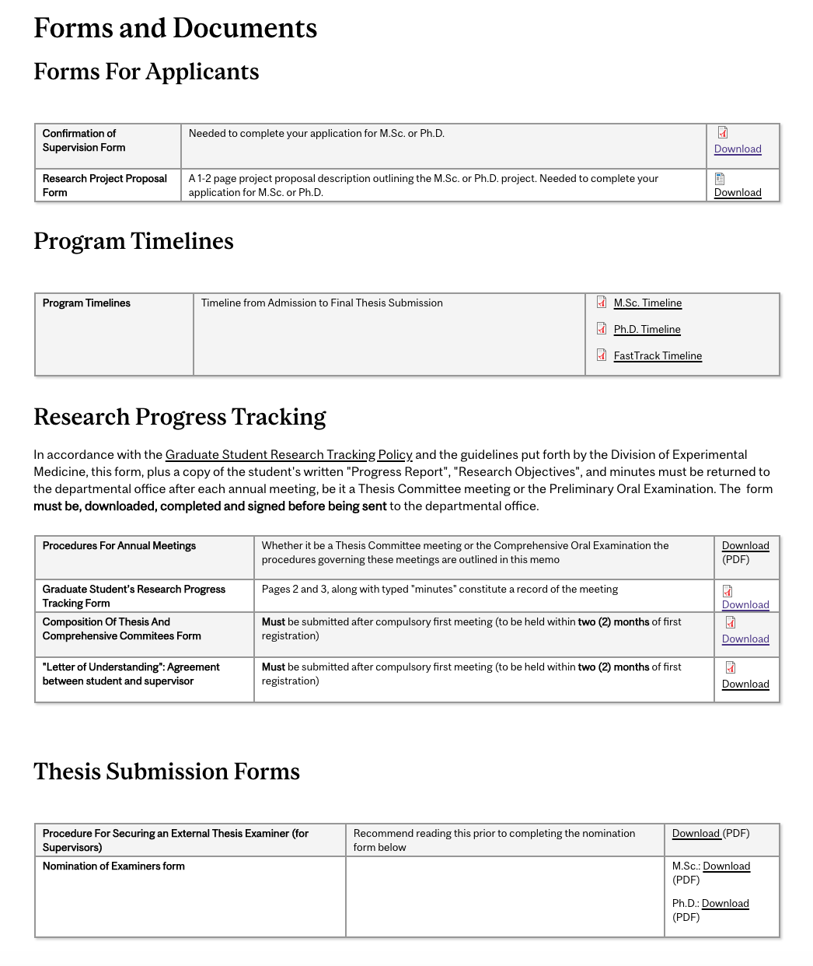
https://www.mcgill.ca/expmed/forms

Slide 38
Thank-you!

