Slide 1
New Student Orientation
orientation
An event by:
September 20th, 2023

Slide 2
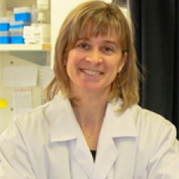
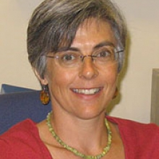
Program Directors
Program Directors
Roles of our Program Directors
Chairs of the departmental committee for graduate admissions.
Primary contact with school of graduate studies.
Review the academic progress.
Review nominations for scholarships and awards.
Coordinate the development of graduate courses, new
programs and/or curriculum changes.
Mediate in problematic situations involving students and faculty.
Review and sign initial thesis submission.
Complete guidelines
Dr. Anne-Marie Lauzon
Graduate Program Director
Dr. Elizabeth Fixman
Associate Program Director

Slide 3
Student Affairs
Student Affairs
For all regular inquiries:
Assist with:
Application and admission process.
Registration inquiries.
Research progress tracking (Thesis Committee meetings).
Travel awards.
External/internal fellowships, graduate awards.
Student requests (leave of absence, withdrawal from
program).
Program requirements.
Email: experimental.medicine@mcgill.ca
Website
Marylin Linhares
(514) 934-1934 ext. 34699
Student Affairs Coordinator
Katrine Couvrette
(514) 934-1934 ext. 34700
Student Affairs Coordinator
For external and internal fellowships, awards, student and supervisor advising:
Sandra Morrison
(514) 934-1934 ext. 36465
Student Affairs Administrator
Notes:
(daily unit operations, program information, admissions, course requirements, registration, etc

Slide 4
EMGSS
EMGSS
The Experimental Medicine Graduate Students' Society (EMGSS):
Who we are: Elected Student Council
Why we exist: To promote and defend the rights, welfare and interests of its members, as well as to enhance their educational, social, cultural and environmental conditions.
What we do: Organize the Annual McGill Biomedical Graduate Conference (AMBGC), as well as hosts a variety of academic, social and sporting events.
More info: emgss.org
Notes:
(daily unit operations, program information, admissions, course requirements, registration, etc

Slide 5
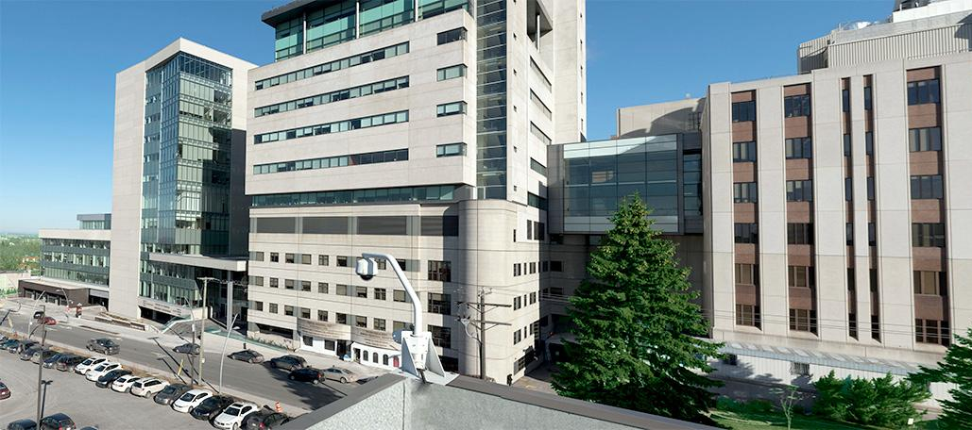
Experimental Medicine sites
Experimental Medicine sites
Research Institute – McGill University Health Centre (RI-MUHC)
Glen Site
Lady Davis Institute (LDI) / Jewish General Hospital

Slide 6
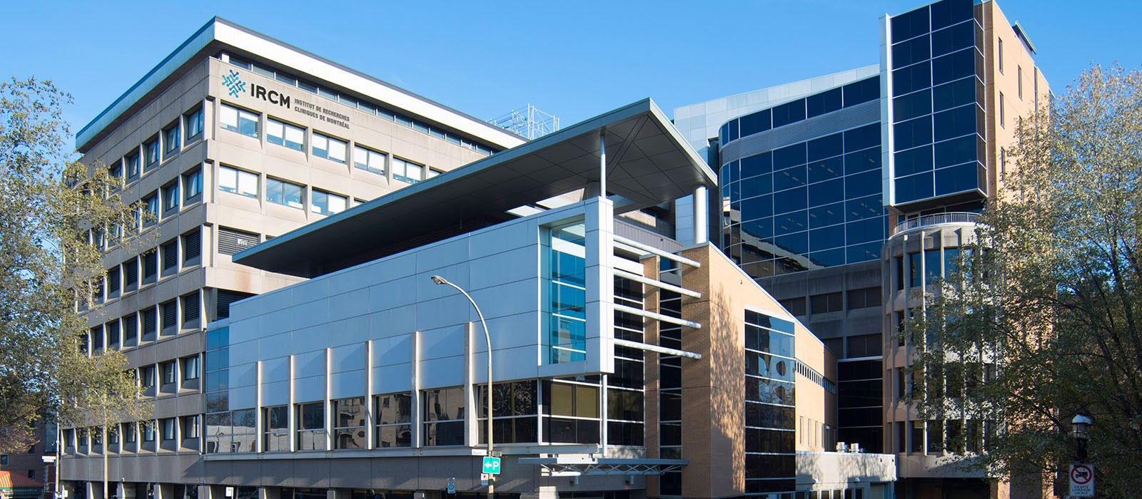
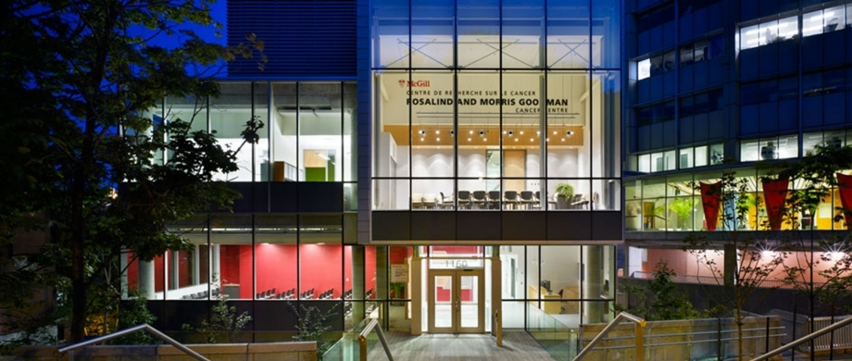
Experimental Medicine sites
Experimental Medicine sites
Institut de recherches cliniques de Montréal (IRCM) / Montreal Clinical Research Institute
Goodman Cancer Institute (GCI) / McIntyre Medical Building

Slide 7
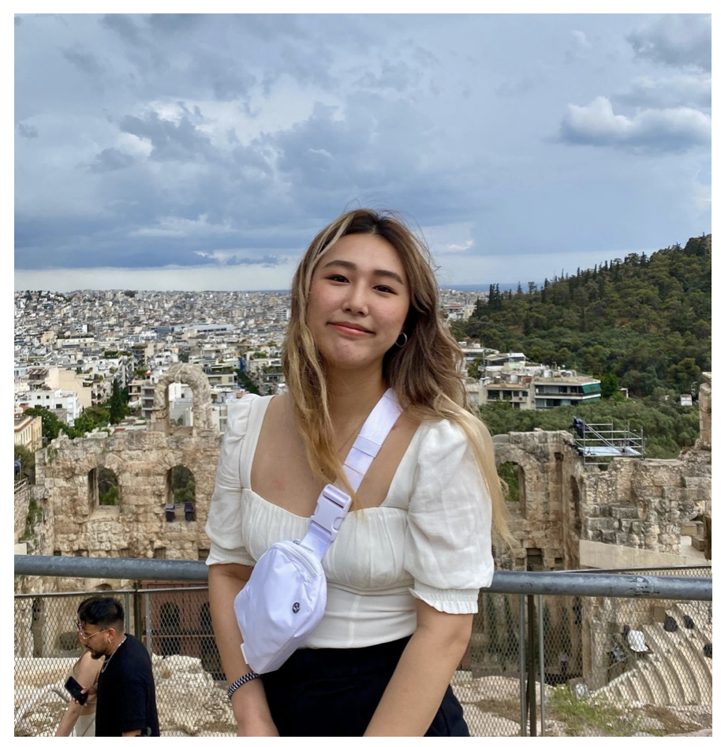
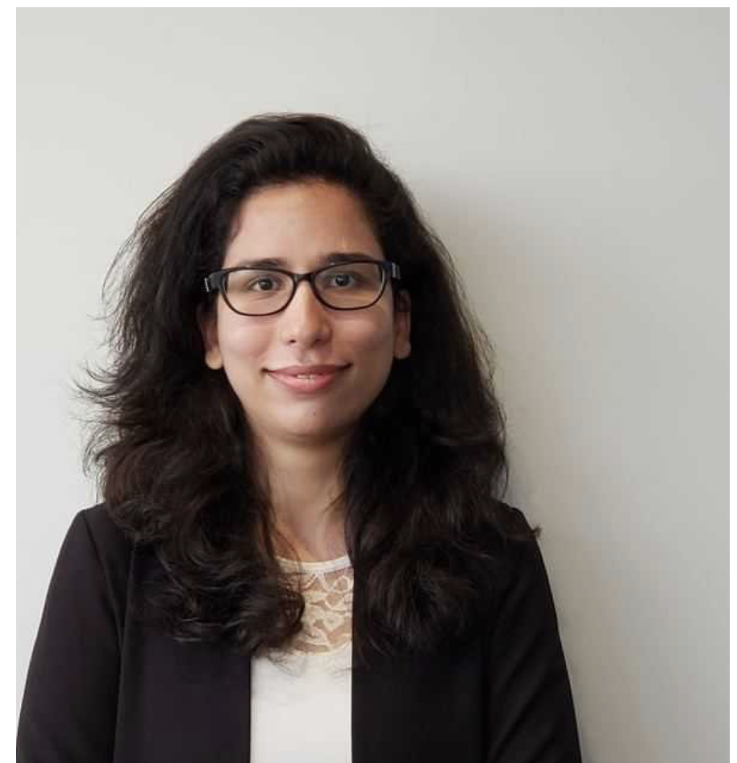
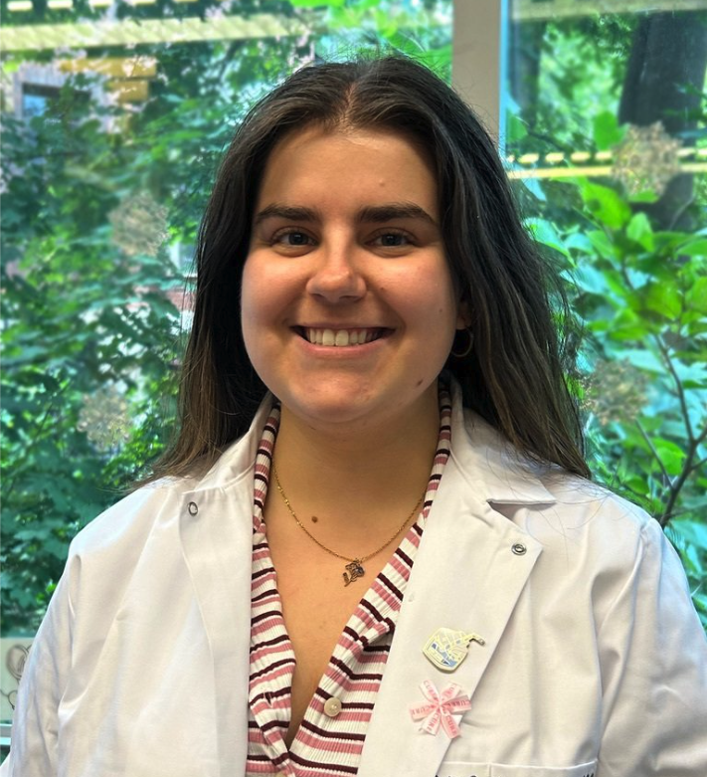
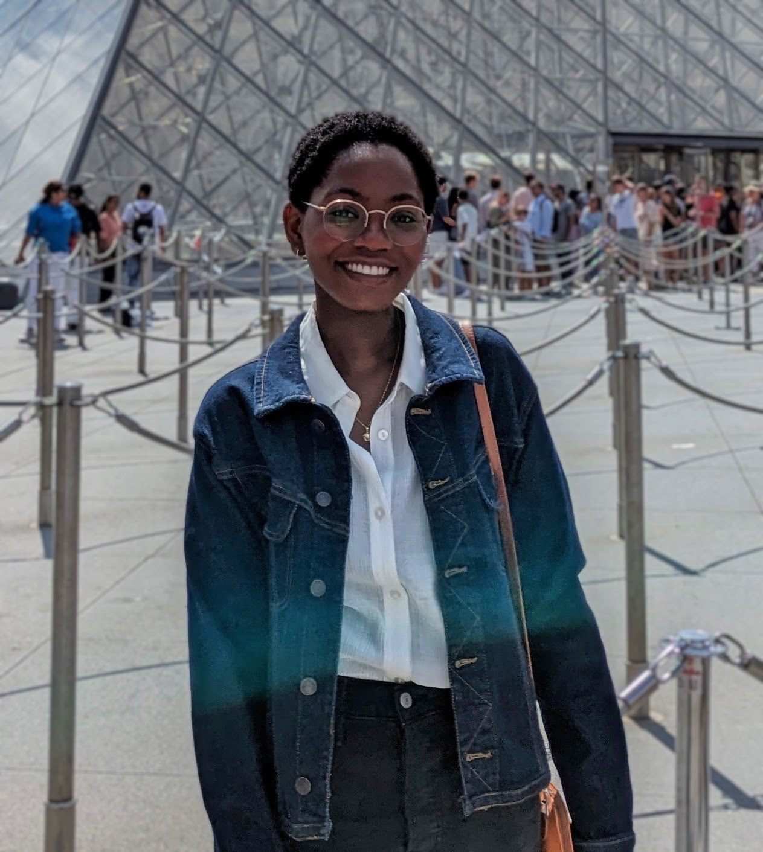
EMGSS: Site Reps
EMGSS: Site Reps
Chantel Mukonoweshuro
LDI
Shayesteh Kiani
IRCM
Rushud Abdulsalam
RI-MUHC
Anne Blouin
GCI
chantel.mukonoweshuro@mail.mcgill.ca
shayesteh.kiani@mail.mcgill.ca
rushud.abdulsalam@mail.mcgill.ca
anne.blouin@mail.mcgill.ca
More info: emgss.org
Notes:
(daily unit operations, program information, admissions, course requirements, registration, etc

Slide 8
Course and thesis requirements
Course and thesis requirements
 | M.Sc. Experimental Medicine | M.Sc. Option in Bioethics | M.Sc. Option in Digital Health Innovation | M.Sc. Option in Environment | Ph.D. Experimental Medicine | Ph.D. Option in Environment | Graduate Diploma Clinical Research | Graduate Certificate in Regenerative Medicine
Coursework Credits | 9 | 21 | 21 | 18 | 12-18* | 21-27 | 12 | 15
Thesis Credits | 36 | 24 | 24 | 27 | - | - | 18 (practicum) | -
Total credits | 45 | 45 | 45 | 45 | 12-18 | 21-27 | 30 | 15
*12 credits when entering with a M.Sc.
Courses offered by the Division of Experimental Medicine
500 or 600 level courses from other departments may be taken but should be confirmed with EXMD
Course registration must be completed by student via Minerva

Slide 9
myPogress
myProgress
myProgress is a tool that tracks graduate students’ progress in their studies
All student records from Minerva.
A list of student milestones to be completed (degree requirements), and their due dates (e.g. thesis committee meetings and course work).
The composition of the students’ thesis committee members, including supervisors, academic advisors and other members, as well as comprehensive oral examination members for Ph.D. students.
This tool is useful for you, your supervisor and academic advisor as it monitors the degree requirements completion and serves as a degree audit tool.
More Information

Slide 10
Internal Travel Awards
Internal Travel Awards
Gerald B. Price and Graduate Research Enhancement and Travel (GREAT) Awards
There are 3 travel award competitions yearly:
February 28th, for conferences between the upcoming May 1st and August 31st
June 30th, for conferences between the upcoming September 1st and December 31st
October 31st, for conferences between the upcoming January 1st and April 30th
Award recipients will be reimbursed for the amount spent to attend the conference for which they received the award, up to a maximum of $1,250 CAD.
Award recipients are determined by way of a random draw among all eligible applicants.
Supervisors are expected to help cover any additional costs up to $650.00 CAD.
More Information

Slide 11
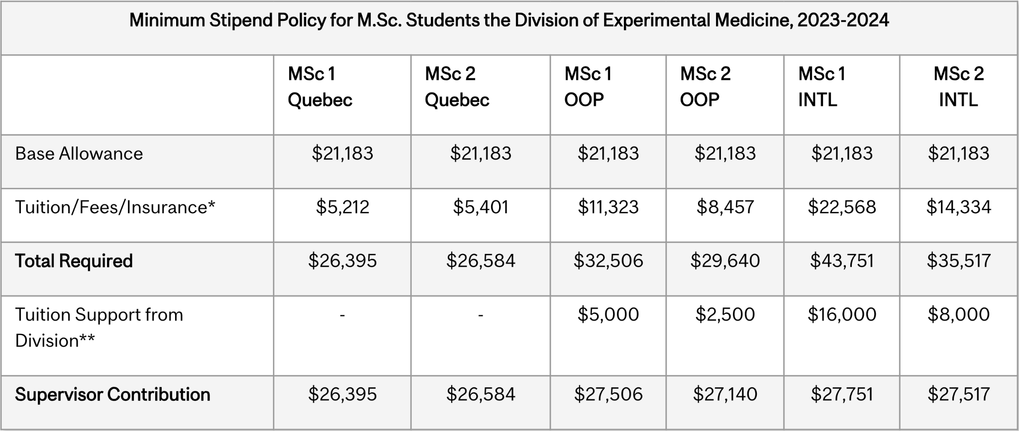
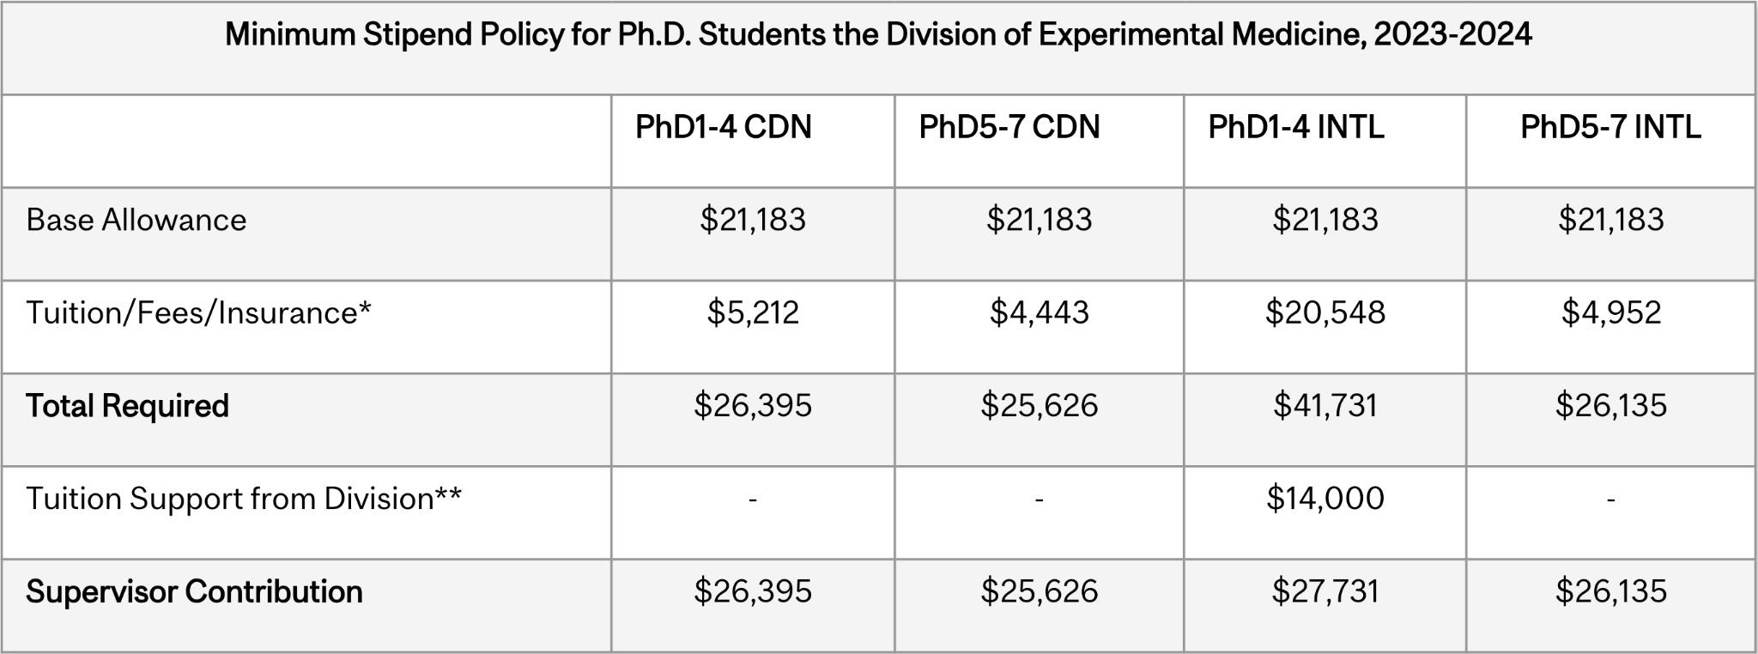
Harmonized Stipend
Harmonized Stipend

Slide 12
Thanks!
Thanks!
Notes:
Fb: EMGSS, Twitter: McGillEMGSS, IG: social.emgss and LinkedIn: EMGSS

